Slide 1

Geographical Addressing
A vehicle to address scalability in LEO Networks
Arashmid Akhavain
Huawei Technologies Canada
IETF 122 – Bangkok
March 2025

Slide 2






Interworking networks in 6G

Slide 3
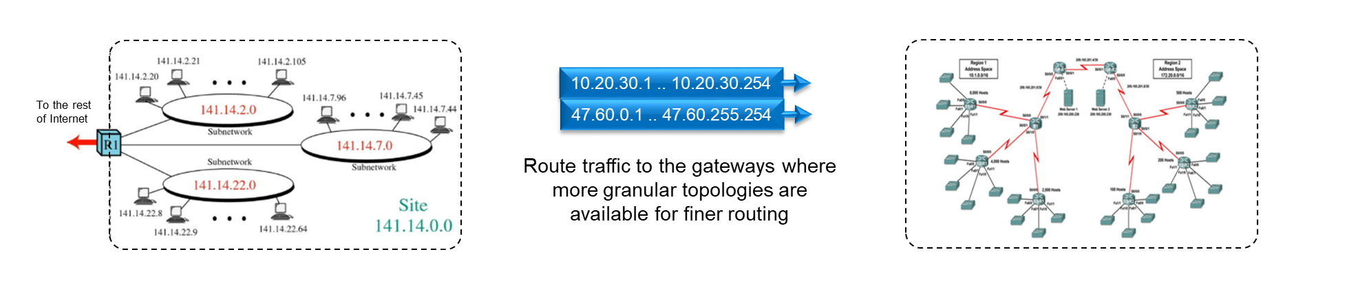
Scalability in IP networks
Existing IP based networks are hierarchical
IP does not lend itself well to nonhierarchical, massive scale networks of thousands of routers and millions of addresses.
IP employs address aggregation and topology abstraction to handle large scale networks.
Address aggregation: Achieved through wildcarding and best prefix match.
Topology abstraction: Achieved via the use of gateways.
Employ gateways and hide topologies behind them.
Route traffic to the gateways where more granular topologies are available for finer routing.
State of the art IP IGPs such as OSPF and ISIS can handle hundreds of routers and hundreds of thousands of addresses.
IP does not provide native support for mobility.
Additional protocols such as VxLAN are devised to support mobility in IP networks.
Hierarchy, address aggregation, and topology abstraction are key IP features for handling large scale networks.

Slide 4
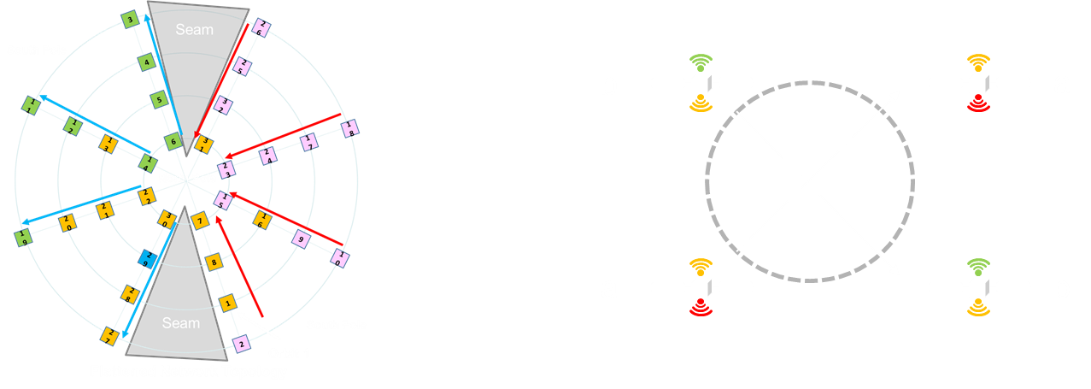
Scalability in IP networks
Traditional link state protocol’s provide us with hierarchical network
modelling via the use of address abstraction & region definition.
Reduced size of routing tables.
Reduced Dijkstra execution time.
Reduced routing updates.
Reduced number of routes to propagate.
BUT
Parameters such as area IDs, interface addresses, etc. are configured attributes.
Adjs. and topology is established based on the above configured attributes.
Changing configured attributes results in outage.
Frequent movement in LEO network is a
Formidable Obstacle for managing areas,
addresses, etc.
Interfaces are swapped at the poles.
Nodes move in/out of areas.
Nodes and areas move w.r.t each other.

Slide 5
Geographical addressing in LEO networks
Geography supports abstraction and aggregation in a natural manner.
Each LEO has
A position w.r.t earth at any given point in time (longitude-latitude/xyz.
Footprint on earth – its coverage area
Devices’ positions on earth fall under different LEOs coverage area at any given
point in time.
Using geographical addressing of devices, the network delivers traffic to the closest
satellite covering any of devices in its coverage area.
Position of a LEO acts as natural abstraction and aggregation for all devices under its coverage area.

Slide 6
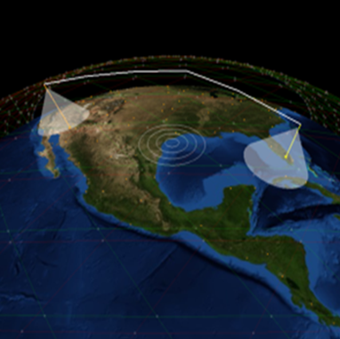
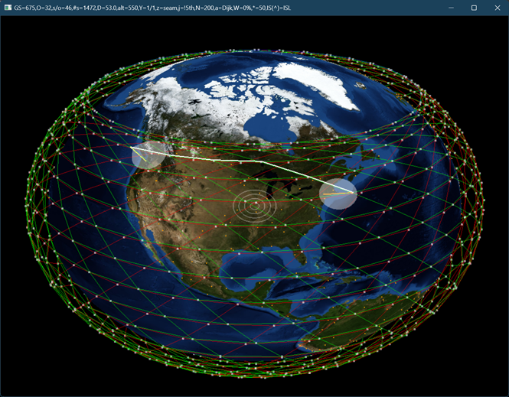
Geographical addressing in LEO networks

